Slide 1

Soldering PCBs & Trimming
MercedEnergy.com
12-06-2018

Slide 2

Safety
Make sure components do not have electricity flowing.
Wash hands after handling solder.
Wear Safety Glasses
No Food
Well ventilated area

Slide 3
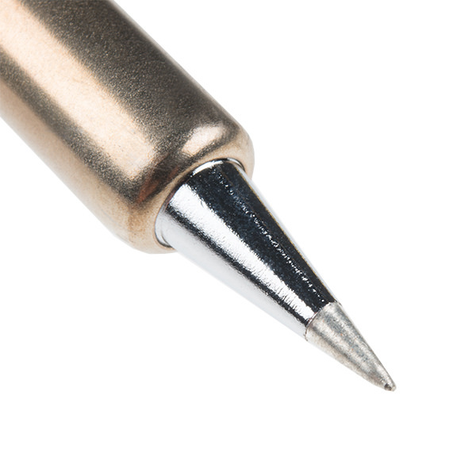
Thinning the tip
Protects from corrosion
Melt solder on it, and wipe it away with sponge.
Keep the tip clean

Slide 4
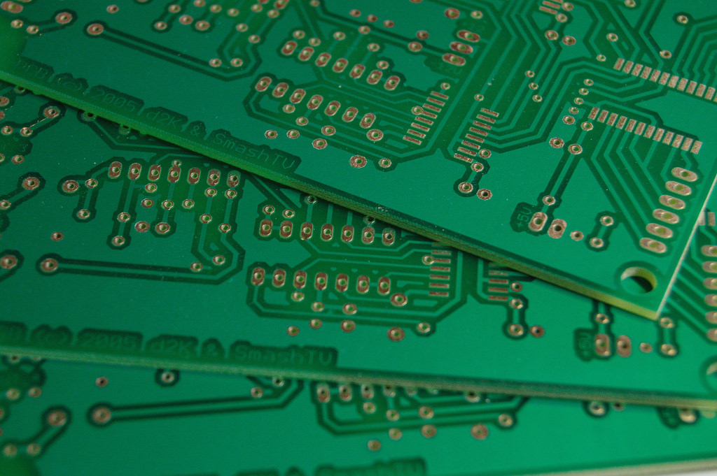
Soldering PCBs
PCB - Printed Circuit Board
Main component of an electronic
Connects resistors, motors, LED, … etc
Electronics are sensitive to static electricity.
Possibly wear an anti-static band

Slide 5
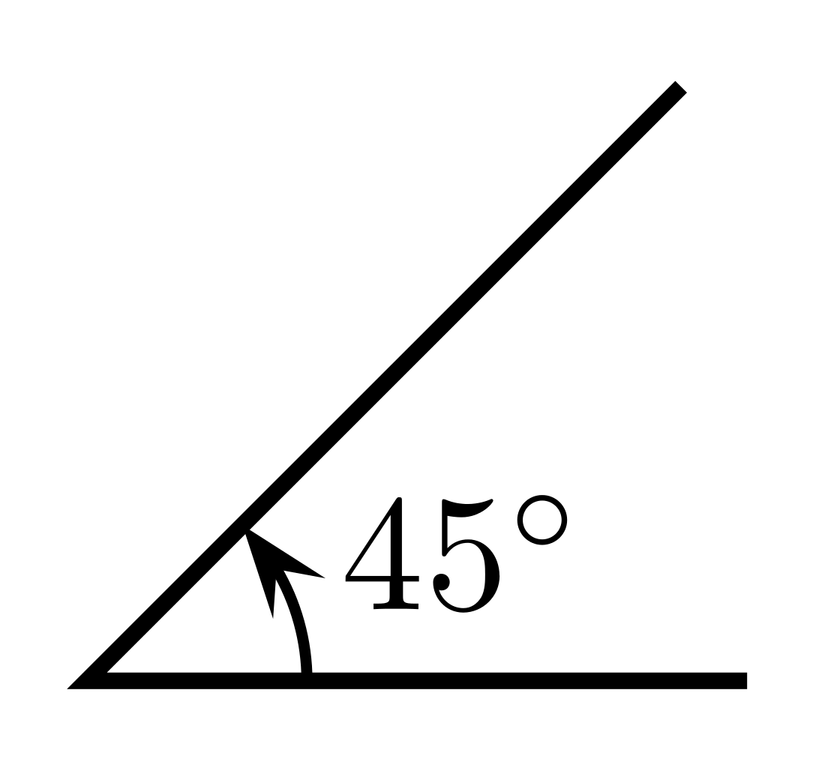
Placing Parts
Place components onto the circuit board
Bend the wires at 45 degree angle.
Do not bend wires too far
If done incorrectly they will fall off.

Slide 6
Soldering Iron Tip
Make sure soldering iron tip is hot enough to melt solder instantly
Apply solder to iron tip. No more than four seconds.
Wetting is when solder melts

Slide 7
Trimming
Do not trim leads to close to circuit board.
May decrease the life.
May decrease the conductivity.

Slide 8
Soldering two seperate pieces of wire
Use the correct tool
Use the third hand

Slide 9
Thank You!
Ramiro Gonzalez
209-962-2524
ramirogonzalez@mercedenergy.com
ramirogonzalez.org

Slide 10
Sources
Vinck, Marc De. Getting Started with Soldering: a Hands-on Guide to Making Electrical and Mechanical Connections. Maker Media, 2017.

